Slide 1
Chapter 2
Review of Basic
Statistical Concepts
Terry Dielman
Applied Regression Analysis:
A Second Course in Business and Economic Statistics, fourth edition
Statistics Review
Copyright © 2005 Brooks/Cole, a division of Thomson Learning, Inc.

Slide 2
2.1 Introduction
Typically a problem in statistics is one of studying a particular population, perhaps all firms in an industry or the lifetime of a certain brand of tire.
In most cases it is not possible to examine the entire population, so we work with a subset of the population called a sample.
This study has two phases. In the first, descriptive statistics are used to explore the data.
In the second, inferential statistics are used to generalize from the sample to the population.
Statistics Review
Copyright © 2005 Brooks/Cole, a division of Thomson Learning, Inc.

Slide 3
Sampling and Statistics
The most common type of sampling is simple random sampling where every item in the population is equally likely to be selected.
Any numerical summary from a sample is a statistic and each one has a different sampling distribution that describes its theoretical behavior.
This theoretical behavior provides the guidelines for the inference process.
Statistics Review
Copyright © 2005 Brooks/Cole, a division of Thomson Learning, Inc.

Slide 4
2.2 Descriptive Statistics
Textbook Table 2.1 shows the 5-year returns as of July 2002 for a random sample of 83 mutual funds.
Just looking at a list of numbers like this provides little useful information.
The field of descriptive statistics can provide several ways to meaningfully summarize such lists, even when there are far more data.
Statistics Review
Copyright © 2005 Brooks/Cole, a division of Thomson Learning, Inc.

Slide 5
Frequency Distributions
The table at right is constructed by breaking the return rates down into 7 categories of equal width.
Each data value falls into a unique bin because rates are to nearest .1%
5-year rates of return | # of funds
-8% to -4.01% | 5
-4% to -0.01% | 6
0% to 3.99% | 17
4% to 7.99% | 34
8% to 11.99% | 12
12% to 15.99% | 8
16% to 19.99% | 1
Statistics Review
Copyright © 2005 Brooks/Cole, a division of Thomson Learning, Inc.

Slide 6
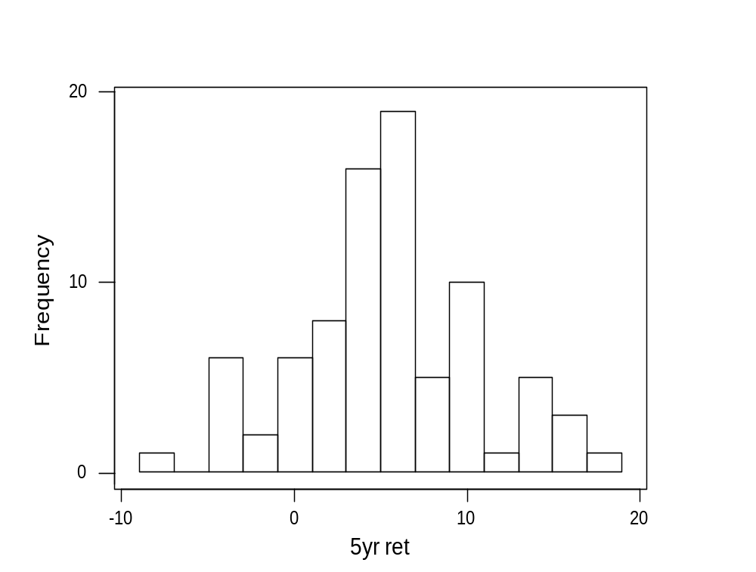
Histograms
A graphical method to display a frequency distribution.
You can get a quick look of the data's symmetry and spread.
Statistics Review
Copyright © 2005 Brooks/Cole, a division of Thomson Learning, Inc.

Slide 7
Numerical Summaries
These are single numbers computed from the sample to describe some characteristic of the data set.
Measures of location include the mean, median and the first and third quartiles.
Measures of spread include the standard deviation, range and midrange.
Statistics Review
Copyright © 2005 Brooks/Cole, a division of Thomson Learning, Inc.

Slide 8
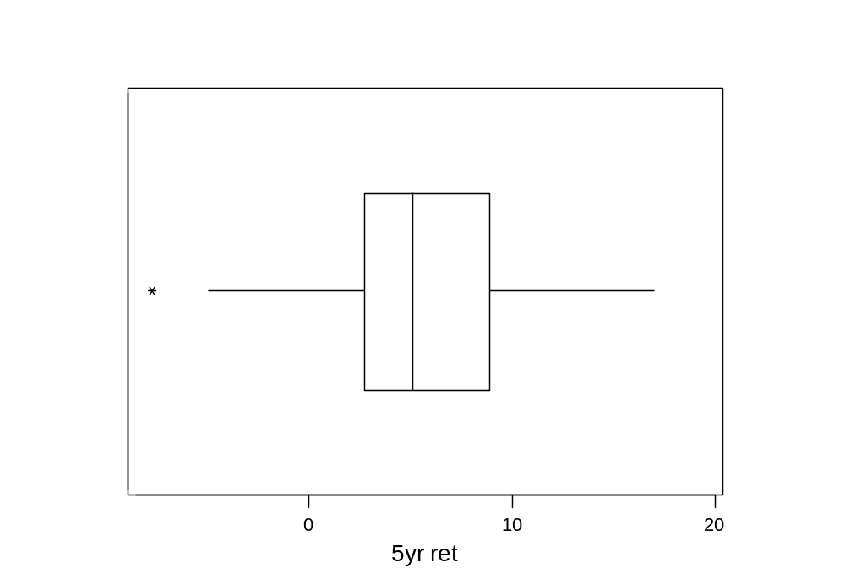
Descriptive Statistics in Minitab
Variable N Mean Median TrMean StDev SE Mean
5yr ret 83 5.371 5.100 5.391 5.229 0.574
Variable Minimum Maximum Q1 Q3
5yr ret -7.800 17.000 2.700 8.900
A boxplot is a good way to display many of the summary stats.
Statistics Review
Copyright © 2005 Brooks/Cole, a division of Thomson Learning, Inc.

Slide 9
2.3 Discrete Random Variables and Probability Distributions
A random variable is a rule that assigns a number to every possible outcome of an experiment.
A discrete random variable is one with a definite distance between each of its possible values.
For example, the number of heads in a single coin toss or the number of kings in two draws from a deck.
Statistics Review
Copyright © 2005 Brooks/Cole, a division of Thomson Learning, Inc.

Slide 10
Probability Distributions
In each experiment, the outcome is determined by chance.
We can assign probabilities to these outcomes and thus to the values of the random variable.
A probability distribution is a list of all the possible values and their associated probabilities.
Statistics Review
Copyright © 2005 Brooks/Cole, a division of Thomson Learning, Inc.

Slide 11
Probability distribution for coin toss
Let X = # heads on a single coin toss
P(x) = the probability that the random variable X takes on value x
x P(x)
0 .5
1 .5
Statistics Review
Copyright © 2005 Brooks/Cole, a division of Thomson Learning, Inc.

Slide 12
Probability Distribution for 2-card Draw
Take Y = # kings in the 2-card draw
y ______P(y)_____
0 188/221 = .8507
1 32/221 = .1448
2 1/221 = .0045
Statistics Review
Copyright © 2005 Brooks/Cole, a division of Thomson Learning, Inc.

Slide 13
Where did these come from?
With a 52-card deck, there are 52*51 = 2652 possible two card draws.
There are 48 cards other than Kings, which is 48*47 = 2256 draws
P(0 Kings) = 2256/2652 = 188/221
Statistics Review
Copyright © 2005 Brooks/Cole, a division of Thomson Learning, Inc.

Slide 14
Laws of Probability
There are two conditions that probabilities must satisfy:
  0 ≤ P(x) ≤ 1
  Sum of all P(x) = 1
This says that each probability must be between 0 and 1, and the total probability in the distribution must add up to 1.
Statistics Review
Copyright © 2005 Brooks/Cole, a division of Thomson Learning, Inc.

Slide 15
Numerical Summaries
When we discussed a sample of observations, we discussed certain numerical summaries.
The ones most often used were the sample mean and standard deviation.
We have similar measures here that describe certain features of the distribution.
Statistics Review
Copyright © 2005 Brooks/Cole, a division of Thomson Learning, Inc.

Slide 16
Profit From Two Investments
x | P(x) |  | y | P(y)
-2000 | .05 |  | 0 | .40
-1000 | .10 |  | 1000 | .20
1000 | .10 |  | 2000 | .20
2000 | .25 |  | 3000 | .10
5000 | .50 |  | 4000 | .10
Statistics Review
Copyright © 2005 Brooks/Cole, a division of Thomson Learning, Inc.

Slide 17
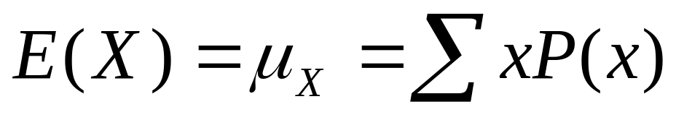
Expected Value
The expected value of a discrete random variable is:
This is a weighted average of the values of X, where the weights are the probabilities.
Statistics Review
Copyright © 2005 Brooks/Cole, a division of Thomson Learning, Inc.

Slide 18
Expected Profit From Two Investments
x | P(x) | xP(x) |  | y | P(y) | yP(y)
-2000 | .05 | -100 |  | 0 | .40 | 0
-1000 | .10 | -100 |  | 1000 | .20 | 200
1000 | .10 | 100 |  | 2000 | .20 | 400
2000 | .25 | 500 |  | 3000 | .10 | 300
5000 | .50 | 2500 |  | 4000 | .10 | 400
 | E(X)= | 2900 |  |  | E(Y)= | 1300
Statistics Review
Copyright © 2005 Brooks/Cole, a division of Thomson Learning, Inc.

Slide 19
An Interpretation
The expected return of investment X is 2900 but this value will never occur. The probability of getting this value is 0, so we can't "expect" it to happen.
A better interpretation of this number is that if we could do this investment many times, this would be the average of all those returns.
Statistics Review
Copyright © 2005 Brooks/Cole, a division of Thomson Learning, Inc.

Slide 20
Investment Risk
Although X clearly has the higher expected return, note that 15% of the time it loses money.
Some people may thus prefer Y because it never loses.
The variance of the returns is sometimes used as a measure of risk.
Statistics Review
Copyright © 2005 Brooks/Cole, a division of Thomson Learning, Inc.

Slide 21
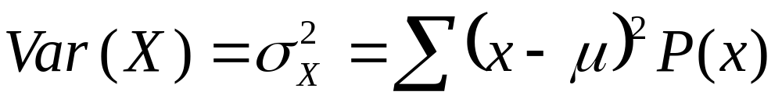
Variance
The variance of a discrete random variable is:
Because this is in squared units ($ squared here), we often work with the square root, σ_{X}.
Statistics Review
Copyright © 2005 Brooks/Cole, a division of Thomson Learning, Inc.

Slide 22
Variance of X
x | P(x) | x-µ_{x} | (x-µ_{x})² | (x-µ_{x})²P(x)
-2000 | .05 | -4900 | 24,010,000 | 1,200,500
-1000 | .10 | -3900 | 15,210,000 | 1,521,000
1000 | .10 | -1900 | 3,610,000 | 361,000
2000 | .25 | -900 | 810,000 | 202,500
5000 | .50 | 2100 | 4,410,000 | 2,205,000
 |  |  | σ_{X}² = | 5,490,000
Statistics Review
Copyright © 2005 Brooks/Cole, a division of Thomson Learning, Inc.

Slide 23
X Has More Risk
We calculate that σ_{X}² = 5,490,000.
A similar calculation for the returns on Y yields σ_{Y}² = 1,810,000 so X both returns and varies more.
The two standard deviations are
σ_{X} = 2343.07 and σ_{Y} = 1345.36
Statistics Review
Copyright © 2005 Brooks/Cole, a division of Thomson Learning, Inc.

Slide 24
2.4 The Normal Distribution
A continuous random variable can take any value over a given range.
The most important one is no doubt the normal random variable whose probability distribution is often depicted as bell-shaped.
It is centered at µ and most of its probability is within 3σ of the mean.
Statistics Review
Copyright © 2005 Brooks/Cole, a division of Thomson Learning, Inc.

Slide 25
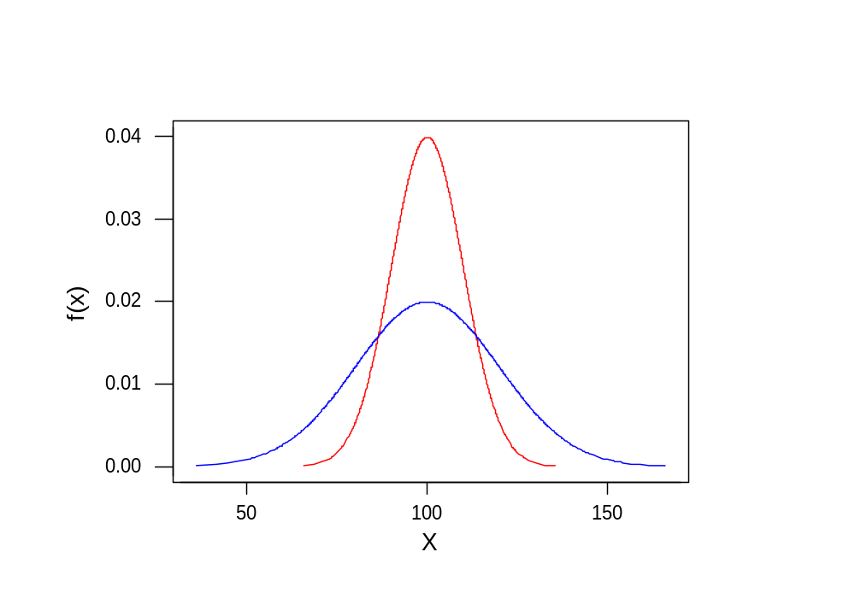
Two Normal Distributions:
___ µ = 100, σ = 10 ---- µ = 100, σ = 20
Statistics Review
Copyright © 2005 Brooks/Cole, a division of Thomson Learning, Inc.

Slide 26
Calculating Normal Probabilities
For any continuous variable, probabilities are areas under the probability curve.
For the normal, these computations have been tabulated (Table B.1).
Because each combination of µ and σ defines a different distribution, the table shows the "standard normal" with mean 0 and standard deviation 1.
Statistics Review
Copyright © 2005 Brooks/Cole, a division of Thomson Learning, Inc.

Slide 27
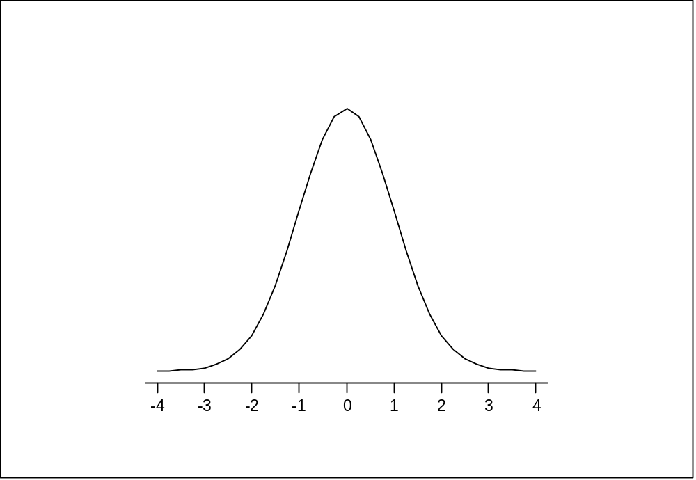
The Standard Normal Distribution
Units of measurement are standard deviations above/below the mean
Statistics Review
Copyright © 2005 Brooks/Cole, a division of Thomson Learning, Inc.

Slide 28
Standardizing
To use the tables with any normally-distributed variable, we convert with the standardizing transformation:
Z = ( X - μ_{X})/σ_{X}
For example, if X has mean 10 and standard deviation 2:
Z = ( X - 10)/2
Statistics Review
Copyright © 2005 Brooks/Cole, a division of Thomson Learning, Inc.

Slide 29
Reverse Standardizing
Sometimes we have the reverse problem, where we know a probability and want to find the X value associated with it.
The probability yields the Z-value, then we get X by:
X = µ_{X} + Z σ_{X}
Statistics Review
Copyright © 2005 Brooks/Cole, a division of Thomson Learning, Inc.

Slide 30
Example 2.2
A large retail firm has accounts receivable that are assumed to be normal with mean µ = $281 and standard deviation σ = $35.
What proportion of accounts are above $316?
Above what value do 13.57% of the accounts lie?
Statistics Review
Copyright © 2005 Brooks/Cole, a division of Thomson Learning, Inc.

Slide 31
Computations for Above 316
Z = ( X - μ)/σ
= (316 – 281)/35
= 35/35 = 1.00
P(Z > 1.00) = .5 - .3413 = .1587
.3413
.1587
281 316
Statistics Review
Copyright © 2005 Brooks/Cole, a division of Thomson Learning, Inc.

Slide 32
Where are the upper 13.57%?
X = μ + Zσ
= 281 + 1.1(35)
= 281 + 38.5
= 319.50
.3643
.1357
Z = 1.1
Statistics Review
Copyright © 2005 Brooks/Cole, a division of Thomson Learning, Inc.

Slide 33

2.5 Populations, Samples and Sampling Distributions
A statistic uses its own sampling distribution to make inference about the population.
For example, is the statistic most often used to make inference about the population mean µ.
The sample mean is a random variable thus follows a probability distribution.
Statistics Review
Copyright © 2005 Brooks/Cole, a division of Thomson Learning, Inc.

Slide 34

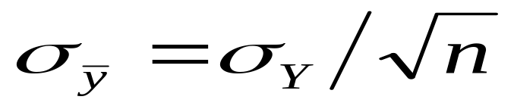
The Sampling Distribution of
Assume the random variable Y has mean µ and standard deviation σ.
We observe a random sample of size n on Y and compute the sample average. The expected value of is µ and the standard deviation of is:
Statistics Review
Copyright © 2005 Brooks/Cole, a division of Thomson Learning, Inc.

Slide 35
Distributional Form
If the observations come from a normal distribution, the sampling distribution is also normal.
The Central Limit Theorem states that the distribution is approximately normal as long as the sample size n is large (usually 30 or more).
Statistics Review
Copyright © 2005 Brooks/Cole, a division of Thomson Learning, Inc.

Slide 36
Example 2.3
In a manufacturing process, the diameter of a certain part averages 40 cm. The variation appears to be normally distributed with standard deviation .2 cm.
If a sample of 16 parts is chosen, what is the probability that the average diameter is greater than 40.1 cm?
Statistics Review
Copyright © 2005 Brooks/Cole, a division of Thomson Learning, Inc.

Slide 37
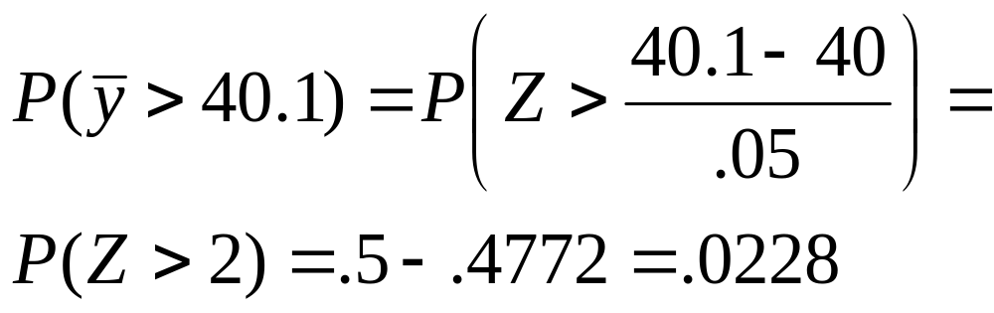
Distribution of average diameter
For n=16, the standard error is
Thus,
Statistics Review
Copyright © 2005 Brooks/Cole, a division of Thomson Learning, Inc.

Slide 38
2.6 Estimating a Population Mean
Point estimates are single numbers used as an estimate of a population parameter.
In general, these will never be exactly right so we use them as the basis for an interval estimate.
Because we base the interval on the sampling distribution, we know the probability content of the interval.
Statistics Review
Copyright © 2005 Brooks/Cole, a division of Thomson Learning, Inc.

Slide 39
The 95% Interval
.9500
.025
.025
-1.96 1.96
Statistics Review
Copyright © 2005 Brooks/Cole, a division of Thomson Learning, Inc.

Slide 40
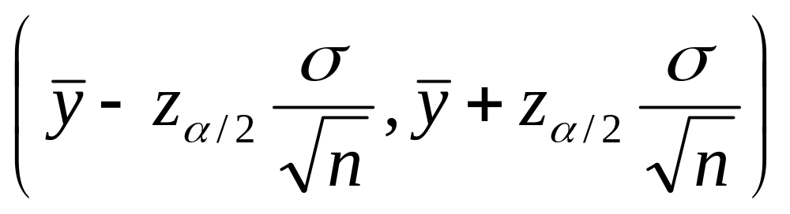
The General Interval
In general, let α denote the total tail probability. A 100(1- α)% confidence interval estimate of µ is:
where z_{α/2} is the standard normal value that has tail probability α/2.
Statistics Review
Copyright © 2005 Brooks/Cole, a division of Thomson Learning, Inc.

Slide 41
Example 2.5
In a department store, the charge account balances of customers has a standard deviation of $45.
They will take a sample of 100 accounts and want to make a 90% interval estimate for all accounts.
If the sample mean is $245, what is the interval estimate?
Statistics Review
Copyright © 2005 Brooks/Cole, a division of Thomson Learning, Inc.

Slide 42
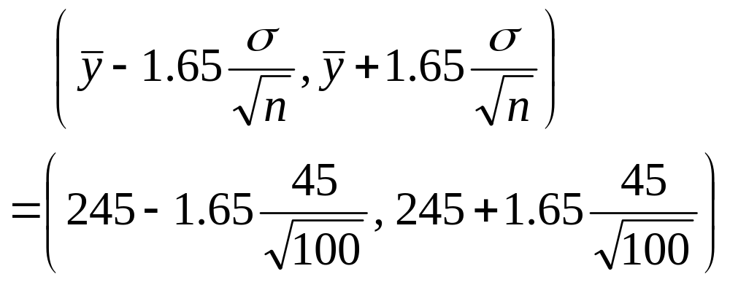
Interval estimate
For a 90% interval, the multiplier is z=1.65. The interval is:
or 245 ± 7.42 = ($237.58 to $252.42)
Statistics Review
Copyright © 2005 Brooks/Cole, a division of Thomson Learning, Inc.

Slide 43
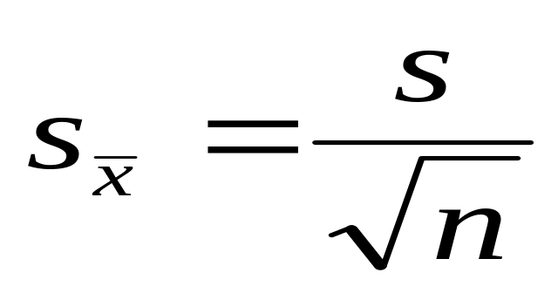
When σ Is Unknown
The previous result required us to know the population standard deviation σ.
In most cases, this is not known and we estimate it by the sample standard deviation, thus have an estimated standard error:
Statistics Review
Copyright © 2005 Brooks/Cole, a division of Thomson Learning, Inc.

Slide 44
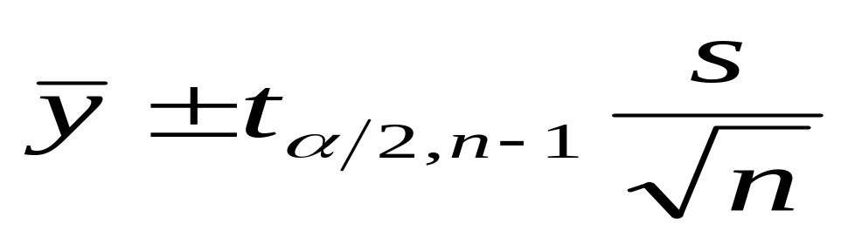
t Distribution Interval
Statistical theory tells us that our interval estimator is now:
where t_{α/2,n-1} is a multiplier from the t distribution with n-1 degrees of freedom.
Statistics Review
Copyright © 2005 Brooks/Cole, a division of Thomson Learning, Inc.

Slide 45
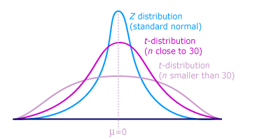
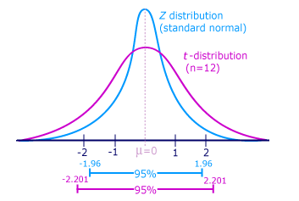
t-distribution vs. Normal distribution
Statistics Review
Copyright © 2005 Brooks/Cole, a division of Thomson Learning, Inc.

Slide 46
Example 2.6
A manufacturer wants to estimate the average life on an expensive electrical component.
Because the test destroys the component, a small sample is used.
If the test results are 92, 110, 115, 103 and 98, find a 95% interval estimate of the average lifetime.
Statistics Review
Copyright © 2005 Brooks/Cole, a division of Thomson Learning, Inc.

Slide 47
Computations
We get = 103.6 and s = 9.18
For n=5, we use the t distribution with 4 degrees of freedom. The multiplier is t_{.025,4} = 2.776.
The interval is:
103.6 ± 2.776(9.18/√5)
103.6 ± 11.40
92.2 to 115.0 hours
Statistics Review
Copyright © 2005 Brooks/Cole, a division of Thomson Learning, Inc.

Slide 48
2.7 Hypothesis Tests About a
Population Mean
In the previous section we discussed estimating an unknown parameter.
Here we use the sample data to test a preconceived belief about the value of a parameter.
We state this belief in a hypothesis, thus the procedure is called hypothesis testing.
Statistics Review
Copyright © 2005 Brooks/Cole, a division of Thomson Learning, Inc.

Slide 49
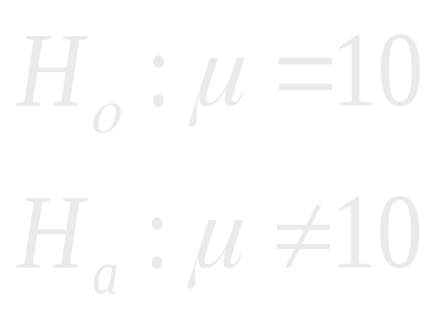
An Example
Is the population average 10?
(On average, mean is 10)
(No it isn't)
Statistics Review
Copyright © 2005 Brooks/Cole, a division of Thomson Learning, Inc.

Slide 50
Notation and Terminology
H₀ is called the Null Hypothesis
H_{a} is called the Alternative or Research Hypothesis
We will set up a decision rule to determine whether we accept or reject the null hypothesis. This rule is constructed after we choose the test's level of significance.
A test statistic will be computed from the sample information to make the decision.
Statistics Review
Copyright © 2005 Brooks/Cole, a division of Thomson Learning, Inc.
Notes:
Multiple Regression I

Slide 51
Level of Significance
If we perform the test and the null hypothesis really is correct, there is a chance we will say it is false because we happened to get some fairly extreme values in our sample.
We control for this by setting up the decision rule so there is a small probability of this happening.
This probability is the level of significance.
Statistics Review
Copyright © 2005 Brooks/Cole, a division of Thomson Learning, Inc.

Slide 52
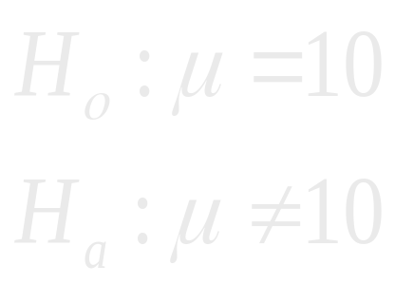
Continuing
Suppose we know that the population standard deviation is 2, and we wish to use a 5% level of significance.
We will reject H₀ if we get either a very large or very small value of the sample average.
Statistics Review
Copyright © 2005 Brooks/Cole, a division of Thomson Learning, Inc.

Slide 53
The Decision Rule for a 5% Level of Significance
Reject if sample average < 9.608
or > 10.392
.9500
.025
.025
-1.96 1.96
C₁ = 9.608 C₂ = 10.392
Statistics Review
Copyright © 2005 Brooks/Cole, a division of Thomson Learning, Inc.

Slide 54
Sample Average as Test Statistic
In this example we were able to use the sample average as our test statistic (reject if average < 9.608 or > 10.392).
Because we knew the standard deviation σ we were able to figure out what points corresponded to the two z critical values.
We could also have worked with a standardized test statistic, which is what we will have to use if σ is unknown.
Statistics Review
Copyright © 2005 Brooks/Cole, a division of Thomson Learning, Inc.

Slide 55
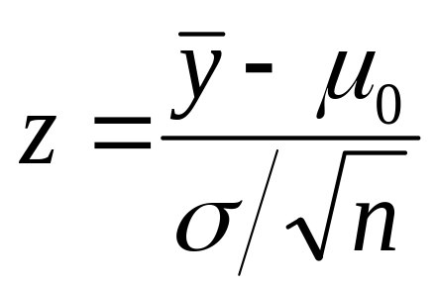
Standardized Test Statistic
We could have worked with:
If so, the decision rule is:
At a 5% level of significance, reject H₀ if z > 1.96 or z < -1.96
Statistics Review
Copyright © 2005 Brooks/Cole, a division of Thomson Learning, Inc.

Slide 56
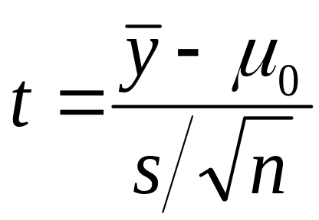
Tests When σ Is Unknown
As in the estimation problem, use the sample standard deviation.
The standardized test statistic is now:
The critical values now come from the t distribution with n-1 degrees of freedom.
Statistics Review
Copyright © 2005 Brooks/Cole, a division of Thomson Learning, Inc.

Slide 57
Example 2.8
A company that manufactures rulers wants to insure the average length is correct (12 inches).
From each production run, a sample of 25 rulers is selected and checked with accurate equipment.
One particular sample had an average of 12.02 inches with a standard deviation .02 inch.
Using a 1% level of significance, test to see if production is on target.
Statistics Review
Copyright © 2005 Brooks/Cole, a division of Thomson Learning, Inc.

Slide 58
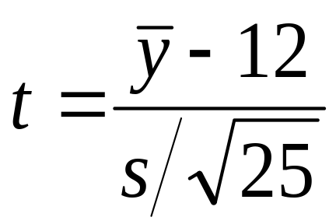
Our example
H₀: μ = 12 (everything OK)
H_{a}: μ ≠ 12 (something wrong)
Decision process: compute
Decision rule:
Reject H₀ if t > t_{.005,25} = 2.797
or if t < -2.797
Statistics Review
Copyright © 2005 Brooks/Cole, a division of Thomson Learning, Inc.
Notes:
Multiple Regression I

Slide 59
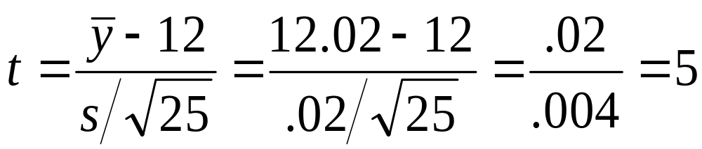
Results
The sample averaged 12.02 with a standard deviation of .02.
Because this is beyond 2.797, we reject H₀ and conclude we are producing rulers longer than 12 inches.
Statistics Review
Copyright © 2005 Brooks/Cole, a division of Thomson Learning, Inc.

Slide 60

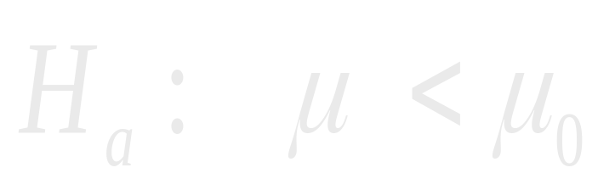
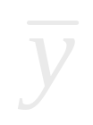
One-Sided Tests (Lower Tail)
Reject H₀ if is too small
Statistics Review
Copyright © 2005 Brooks/Cole, a division of Thomson Learning, Inc.
Notes:
Multiple Regression I

Slide 61

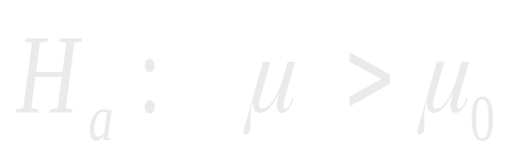
One-Sided Tests (Upper Tail)
This time reject H₀ if is too large
Statistics Review
Copyright © 2005 Brooks/Cole, a division of Thomson Learning, Inc.
Notes:
Multiple Regression I

Slide 62
P-Value
Most software packages report the results of a hypothesis test computing the p-value of the test.
This is just a probability that says how far out in the tail the test statistic fell.
An equivalent decision rule is this:
Reject H₀ if the p-value < α
Statistics Review
Copyright © 2005 Brooks/Cole, a division of Thomson Learning, Inc.

Slide 63
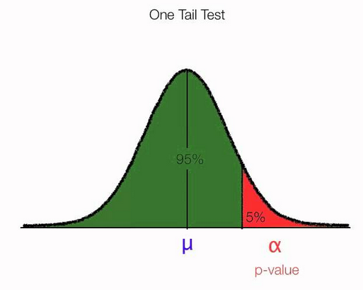
Alpha & P-value
If p-value < alpha , then we could reject Ho : mu = mu_o
Statistics Review
Copyright © 2005 Brooks/Cole, a division of Thomson Learning, Inc.

Slide 64
Example
We have a one–sided test:
H₀: µ ≤ 10
H_{a}: µ > 10
If we knew that σ was 10, sampled n=100 and obtained a sample average of 12, what is the p-value?
Statistics Review
Copyright © 2005 Brooks/Cole, a division of Thomson Learning, Inc.

Slide 65
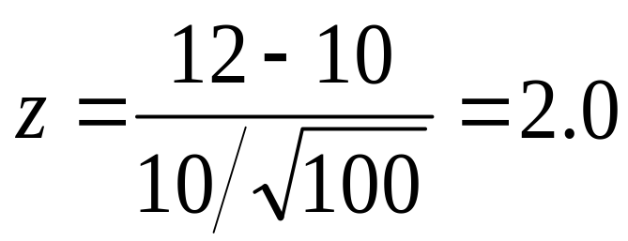
P Value
First find the value of the test statistic.
Now find tail probability beyond the computed value.
P = .0228
z = 2.00
Statistics Review
Copyright © 2005 Brooks/Cole, a division of Thomson Learning, Inc.

Slide 66
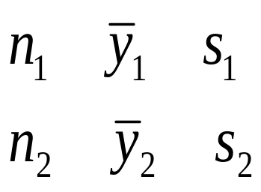
2.8 Estimating the Difference Between Two Population Means
Here we have two samples and two sets of statistics:
Sample 1:
Sample 2:
and want to use them to estimate the difference between the two population means, µ₁ and µ₂
Statistics Review
Copyright © 2005 Brooks/Cole, a division of Thomson Learning, Inc.
Notes:
Multiple Regression I

Slide 67
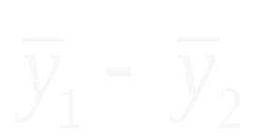
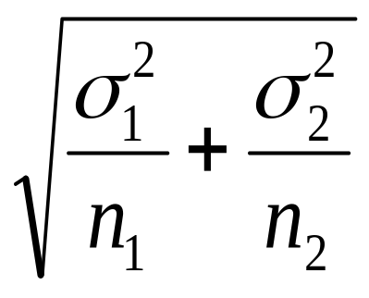
Estimate and Standard Error
A good estimate of the difference in means, (µ₁ - µ₂) is the difference in sample means, .
If we know the standard deviations, the standard error of is:
Statistics Review
Copyright © 2005 Brooks/Cole, a division of Thomson Learning, Inc.

Slide 68
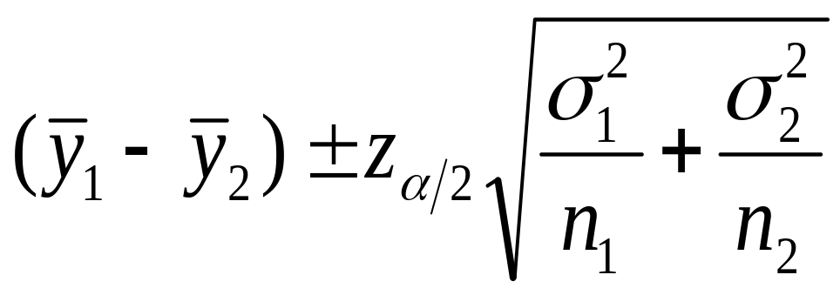
Interval Estimate
If we are sampling from two normal populations, an interval estimate is:
We can also use this as a good approximate interval if both sample sizes are large (n₁ ≥ 30 and n₂ ≥ 30).
Statistics Review
Copyright © 2005 Brooks/Cole, a division of Thomson Learning, Inc.

Slide 69
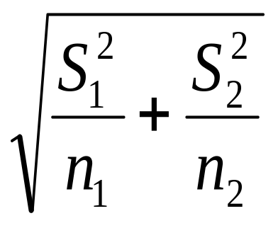
Unknown σ₁ and σ₂
We can use this formula only if the population standard deviations are known.
If they are not, we can use the sample standard deviations and get:
Statistics Review
Copyright © 2005 Brooks/Cole, a division of Thomson Learning, Inc.

Slide 70
The Approximate Interval
As before, use of the sample standard deviations means we use a t distribution for the multiplier.
In this case, the results are only approximate and the t distribution has Δ degrees of freedom (see the text for how Δ is computed.)
Statistics Review
Copyright © 2005 Brooks/Cole, a division of Thomson Learning, Inc.

Slide 71
The Pooled Variance Estimate
In some cases, it may be reasonable to assume that σ₁ and σ₂ are approximately equal, in which case we need only estimate their common value.
For this purpose, we "pool" the two sample variances and get S_{p}² which is a weighted average of the two sample variances.
Statistics Review
Copyright © 2005 Brooks/Cole, a division of Thomson Learning, Inc.

Slide 72
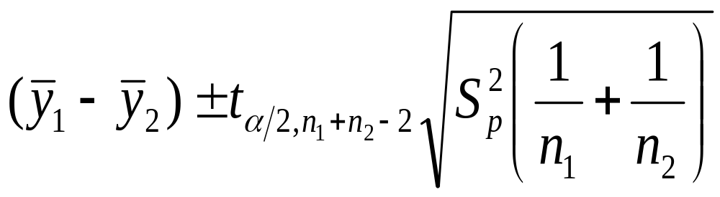
The Exact (pooled sample) Interval
If this is the situation, we can compute an exact interval:
Note that the pooling allows us to combine degrees of freedom:
df = (n₁-1)+(n₂-1) = n₁ + n₂ -2
Statistics Review
Copyright © 2005 Brooks/Cole, a division of Thomson Learning, Inc.

Slide 73
What Should We Use?
If we know the two population variances are about equal, use the exact procedure.
If we think they differ a lot, we should use the approximate result.
If we do not really know, the approximate approach is probably best.
Statistics Review
Copyright © 2005 Brooks/Cole, a division of Thomson Learning, Inc.

Slide 74
Example 2.10
For the 83 mutual funds we discussed earlier, we want to compare the five-year returns for load funds versus no-load funds.
The Minitab output for both procedures is on the next slide. The exact procedure output is on the lower half.
Statistics Review
Copyright © 2005 Brooks/Cole, a division of Thomson Learning, Inc.

Slide 75
Minitab Two-Sample Output
Two-sample T for 5yr ret
LoadNoLo N Mean StDev SE Mean
0 32 5.95 5.88 1.0
1 51 5.01 4.80 0.67
Difference = mu (0) - mu (1)
Estimate for difference: 0.94
95% CI for difference: (-1.54, 3.42)
T-Test of difference = 0 (vs not =): T-Value = 0.76 P-Value = 0.450 DF=56
Two-sample T for 5yr ret
LoadNoLo N Mean StDev SE Mean
0 32 5.95 5.88 1.0
1 51 5.01 4.80 0.67
Difference = mu (0) - mu (1)
Estimate for difference: 0.94
95% CI for difference: (-1.41, 3.29)
T-Test of difference = 0 (vs not =): T-Value = 0.80 P-Value = 0.428 DF=81
Both use Pooled StDev = 5.24
Approximate
Exact
(uses pooled SD)
Statistics Review
Copyright © 2005 Brooks/Cole, a division of Thomson Learning, Inc.

Slide 76
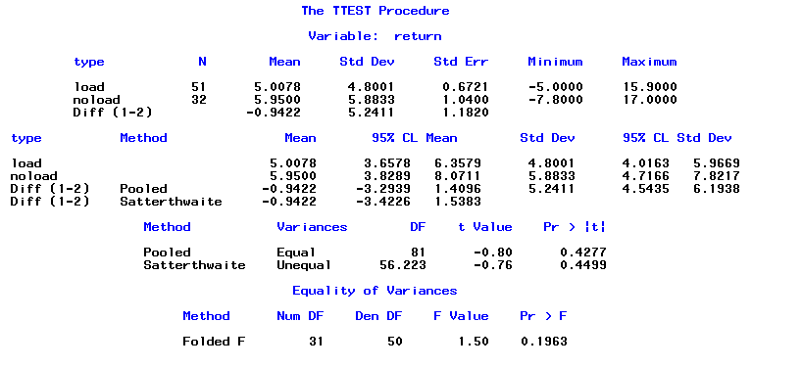
SAS Two-Sample Output
Exact
Approximate
Statistics Review
Copyright © 2005 Brooks/Cole, a division of Thomson Learning, Inc.

Slide 77
HW #1 (due to Sept. 8th)
write the SAS source code for
  Make a library “library” at “c:\sastemp” directory
  Copy “loadno2.xpt“ to “c:\temp” directory
  Import “loadno2.xpt“ file at c:\temp as a SAS data set at “library” (c:\sastemp)
  (see the manual at e-class)
  Create a data set “final” which has
    ‘Type’ and ‘Return’ variables only
    Type = “noload5” or “loan5”
    Return = return value
  Use PROC TTEST for two-sample t-test
    which will produce the previous page output
Statistics Review
Copyright © 2005 Brooks/Cole, a division of Thomson Learning, Inc.

Slide 78
Interpretation
Since we do not have information that the population variances are equal, it is best to use the approximate procedure.
The degrees of freedom are Δ=56 and the interval estimate of (µ_{NoLoad} - µ_{Load}) is
-1.538 to 3.423.
Because this interval contains zero, we can conclude the return rates are not that different.
Statistics Review
Copyright © 2005 Brooks/Cole, a division of Thomson Learning, Inc.

Slide 79
2.9 Hypothesis Tests About the Difference Between Two Population Means
Our test is of the form:
H₀: µ₁ = µ₂ (No difference)
H_{a}: µ₁ ≠ µ₂ (One is higher)
which has an equivalent form:
H₀: µ₁ - µ₂ = 0 (Difference is zero)
H_{a}: µ₁ - µ₂ ≠ 0 (Difference not zero)
Statistics Review
Copyright © 2005 Brooks/Cole, a division of Thomson Learning, Inc.

Slide 80
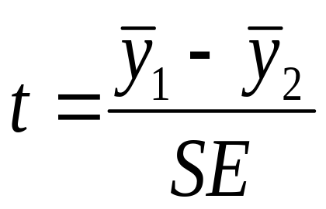
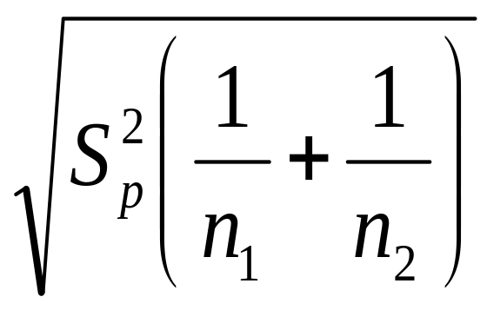
Test Statistic
For the hypothesis of zero difference, the test statistic is just:
The standard error (SE) is either:
or
Statistics Review
Copyright © 2005 Brooks/Cole, a division of Thomson Learning, Inc.

Slide 81
Choice of Procedure
As before, we use the approximate procedure with Δ degrees of freedom if we cannot assume σ₁ and σ₂ are equal to some common value.
If that is a reasonable assumption, we compute the pooled standard error and use the exact procedure with (n₁+n₂-2) degrees of freedom.
Statistics Review
Copyright © 2005 Brooks/Cole, a division of Thomson Learning, Inc.

Slide 82
Example
To test the hypothesis that load and no load funds have the same return, we write:
H₀: µ_{N} - µ_{L} = 0
H_{a}: µ_{N} - µ_{L} ≠ 0
We do not know that the variances are equal, so we use the approximate procedure which has Δ = 56 degrees of freedom.
Statistics Review
Copyright © 2005 Brooks/Cole, a division of Thomson Learning, Inc.

Slide 83
Results
At a 5% level of significance,
Reject H₀ if t > t_{.025,56} ≈ 1.96**
or t < -1.96
Minitab gives us t = 0.76 so we accept H₀ and will conclude there is no difference in average return.
**The correct value for a t₅₆ is 2.003.
Statistics Review
Copyright © 2005 Brooks/Cole, a division of Thomson Learning, Inc.

